Slide 1
Vision-based Probing and Sensing Automation

Slide 2
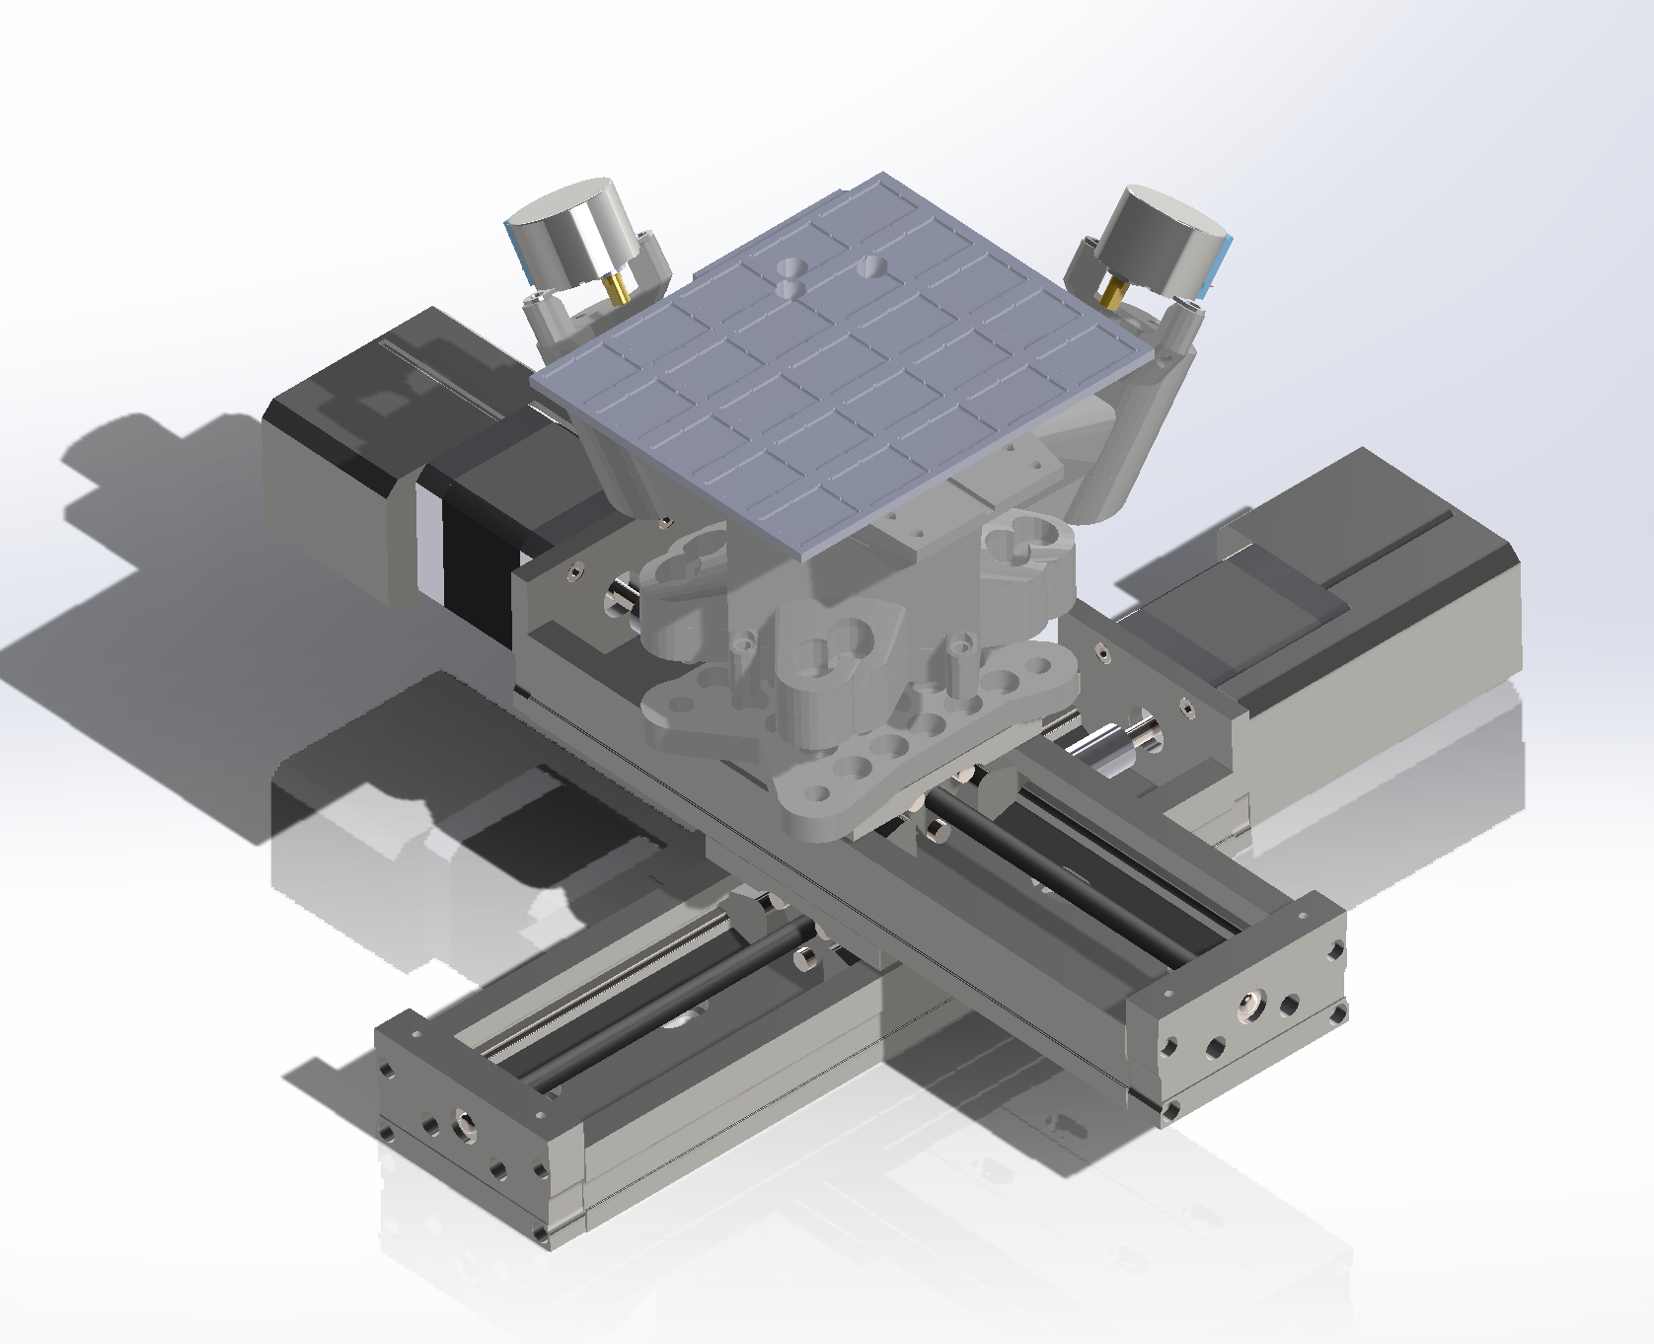
System layout :

Slide 3
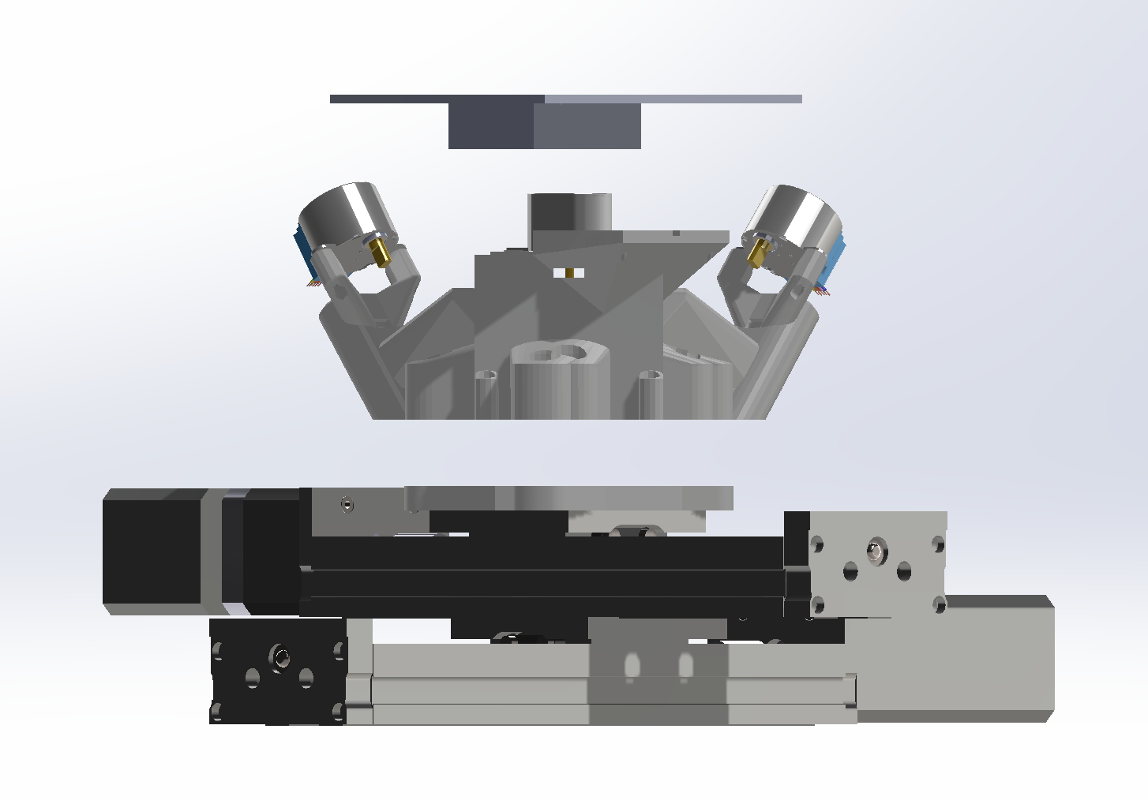
System layout :
Sample holder
Correction stage (openflexture block stage)
Base
Zaber X-LSQ150A

Slide 4
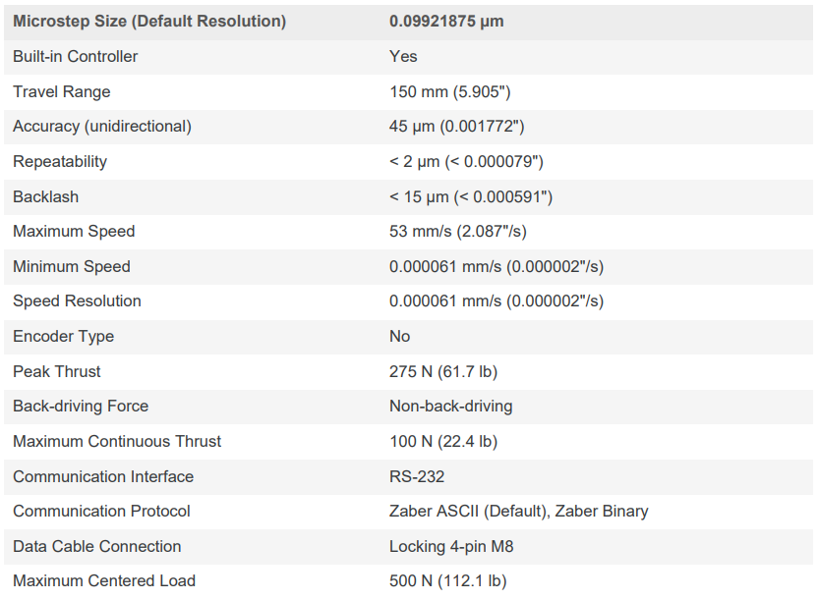
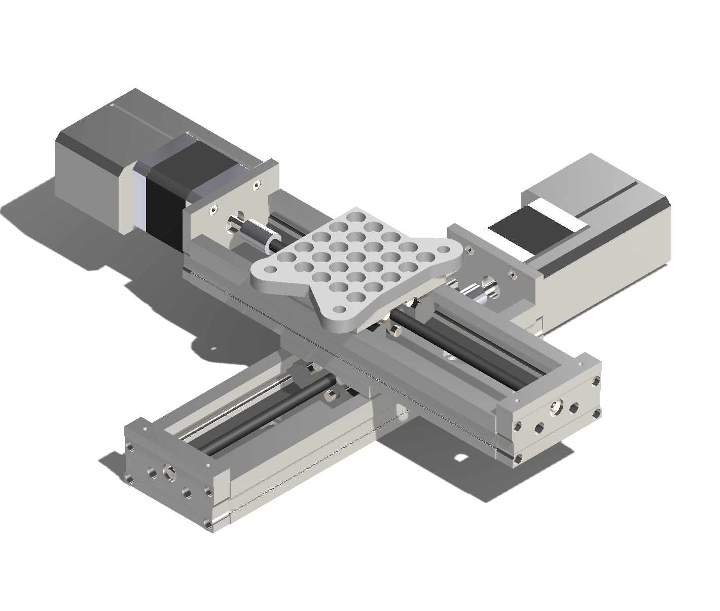
Primary movement : 2x Zaber stages
Zaber Technologies

Slide 5
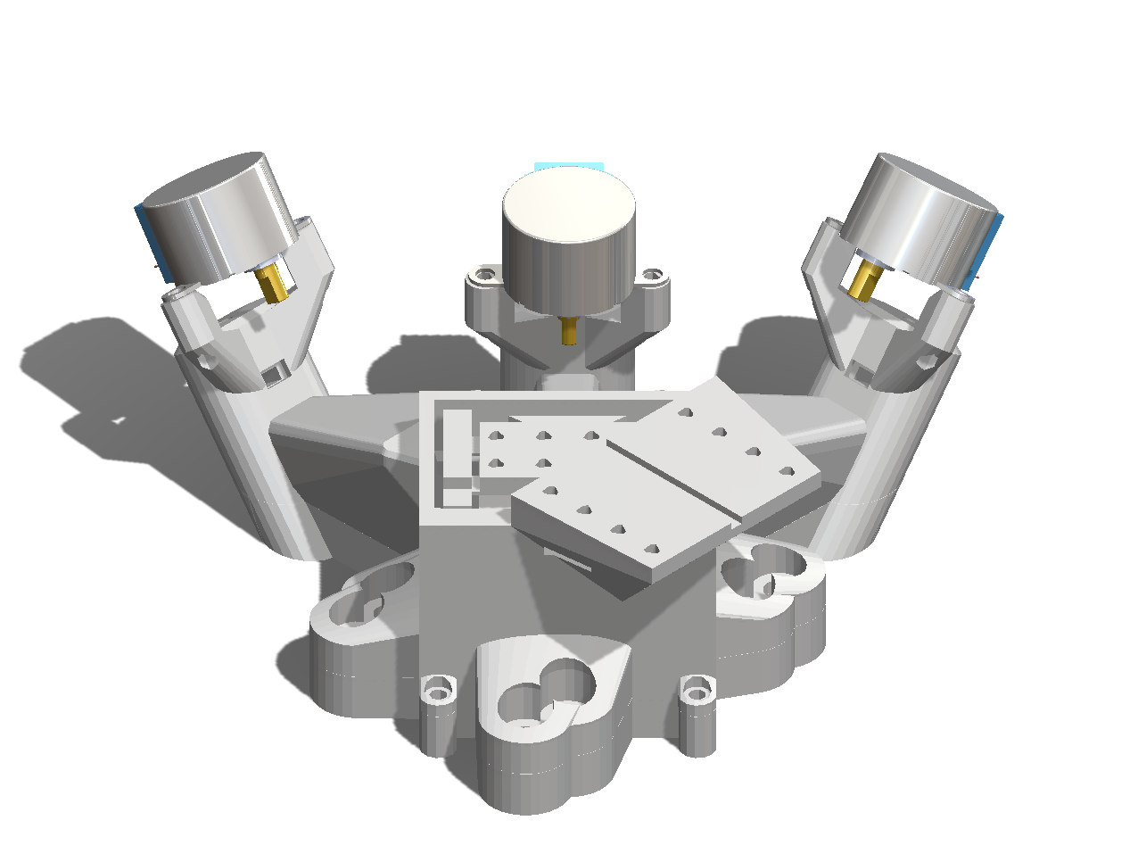
Correction movement : Block stage
Openflexture block stage : based on flextural joints.
Monolithic 3D printable stage
Travel cube 2mmx2mmx2mm
Driven by 3 28BYJ48 (the cheapest) stepper motor
Accuracy of <100nm, unidirectional
Step resolution for current setup is 4px/step at 10x zoom (need to calculate in nm)
Maximum speed (limited by drivers) : 150 steps/min
This moves
OpenFlexure Block Stage

